Slide 1
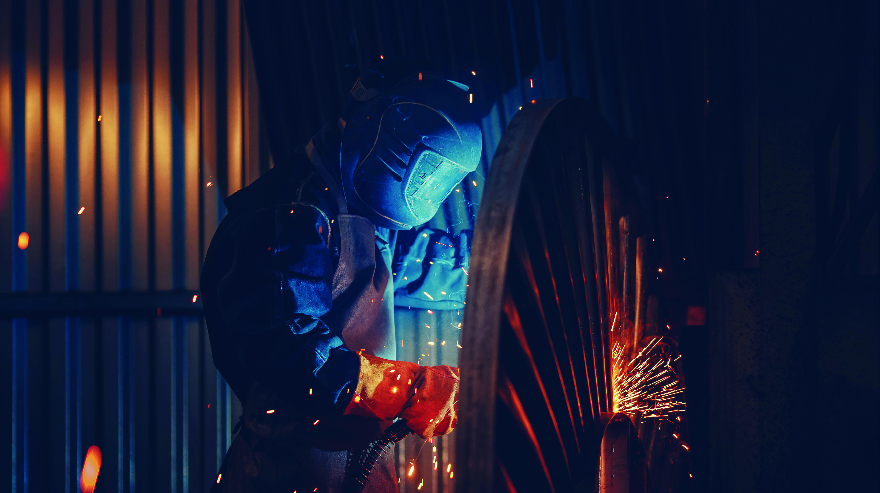



24th INTERNATIONAL
EXHIBITION OF WELDING
MATERIALS, EQUIPMENT
AND TECHNOLOGIES
7–10.10.2025
CROCUS EXPO, MOSCOW
EXHIBITION ADVERTISING OPPORTUNITIES
co-located with
3rd INTERNATIONAL EXHIBITION OF FASTENERS AND INDUSTRIAL SUPPLY

Slide 2


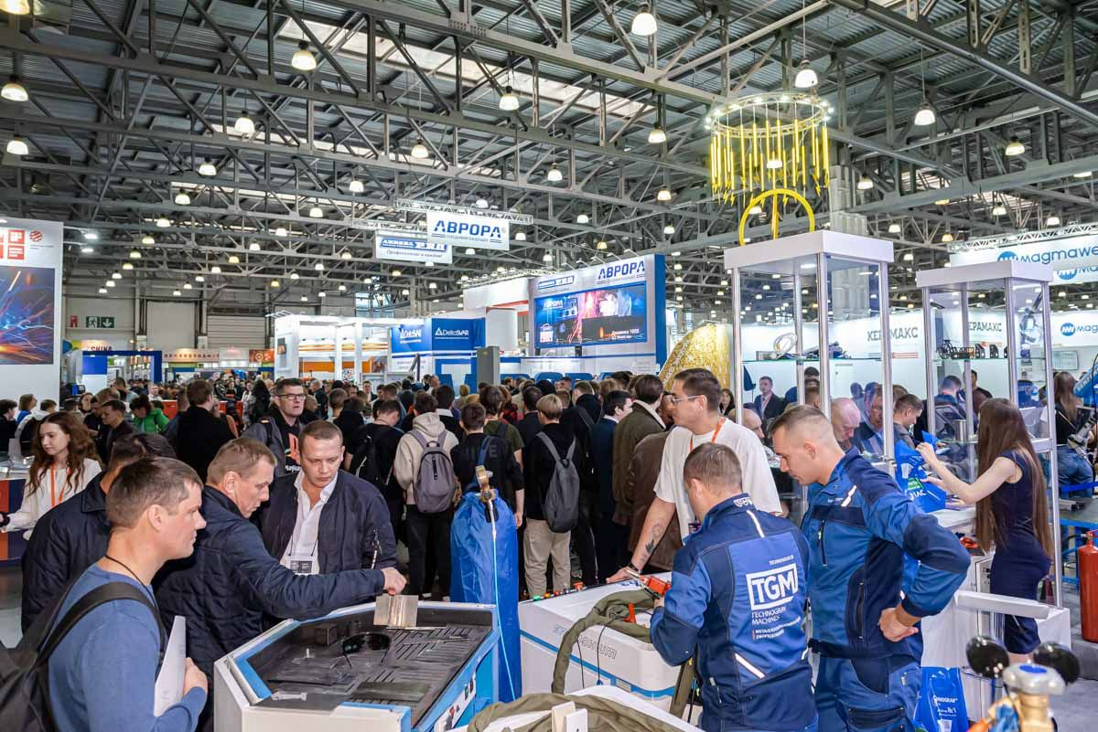




Exhibition advertising opportunities
STAND OUT AMONG YOUR COMPETITORS AT WELDEX AND FASTENEX 2024
The advertising opportunities of Weldex and Fastenex will allow you to attract the attention of a significant professional audience to your products and brands long before, during and after exhibitions.
USE ADVERTISING OPTIONS TO:
Influence a large number of your potential customers and convert them into sales
Increase your brand awareness and make it stand out from your competitors
Focus the visitors’ attention on your products and ensure maximum visitor traffic to your stand
THE COST OF THE SERVICES LISTED IN THE MANUAL IS INDICATED WITHOUT VAT AND OTHER SIMILAR TAXES OF THE RUSSIAN FEDERATION

Slide 3



Exhibition advertising opportunities
EXHIBITION STATISTICS
6 859
76
45 000+
5 061
57
from
from
unique visitors
Russian regions
email subscribers
unique visitors
Russian regions
2 887
249 793
29 130
22 000+
new visitors
7 723
unique website visitors
per year
unique website
visitors per year
email subscribers
received e-tickets to the exhibition

Slide 4
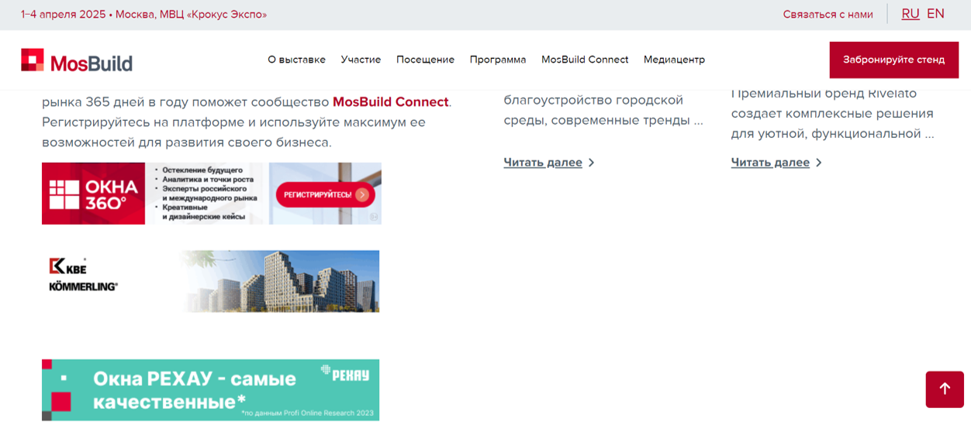

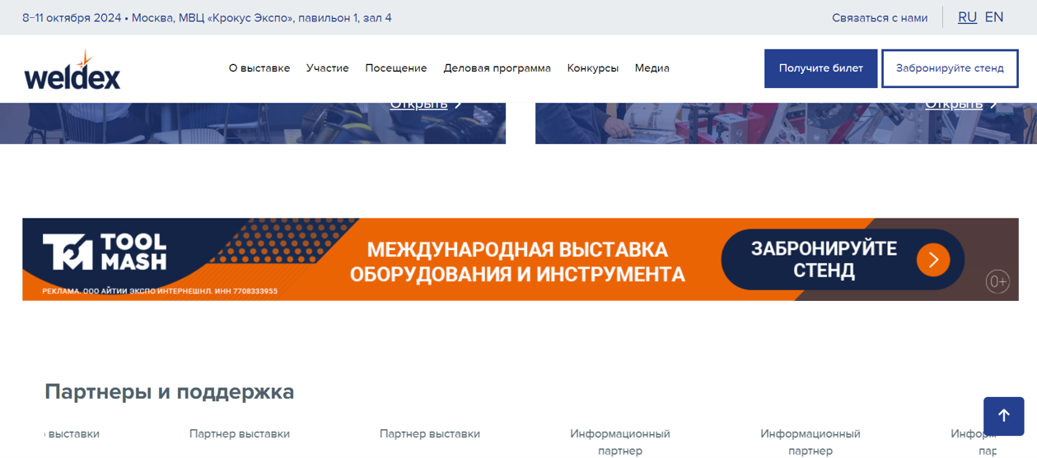


ONLINE ADVERTISING
Advertisement on the weldex.ru and fastenex.ru websites
Be in trend and get the most out of online promotion! According to the Mediascope study, people in Russia spend on average about 4 hours a day on the Internet. Place your company banner on Weldex and Fastenex websites and be in front of your target audience every day.
Banner 435х80
1.1 | Banner 435х80 px / 1 month | 930 euro
1.2 | Banner 1366х114 px / 1 month | 1 860 euro
Banner 1266х114
Advertisement in emails
Newsletters are one of the most powerful tools for direct communication with the audience. Our mailing list contains the first persons of companies that make decisions on equipment purchases. The presence of your logo in emails will help you clearly and at the same time natively draw your potential customers’ attention to your company.
Exhibition advertising opportunities
2.1 | Placement of the company logo in one email for visitors | 1 540 euro.
2.2 | Placement of the company logo in all emails for visitors (more than 30 emails) | 3 000 euro
Logo in email
Logo in all emails

Slide 5

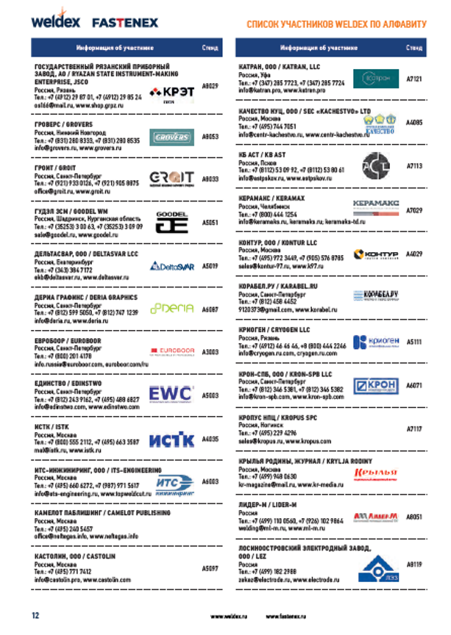
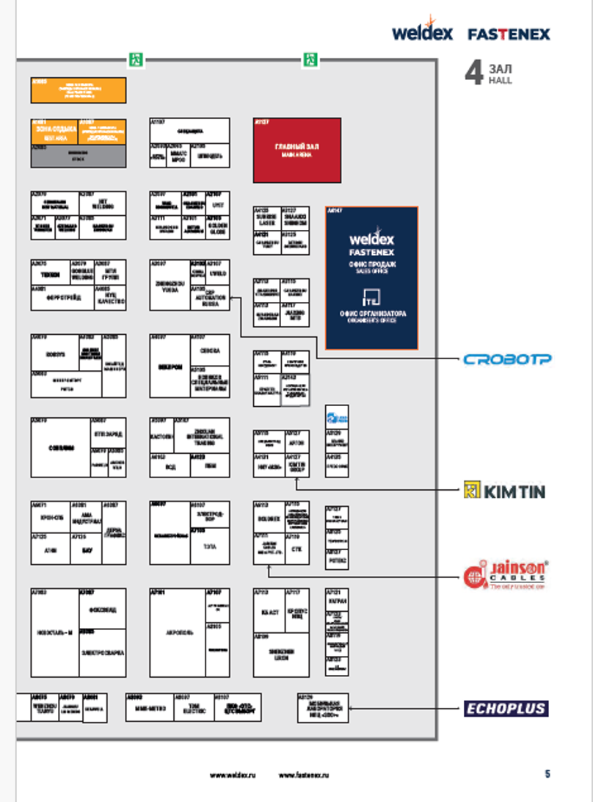

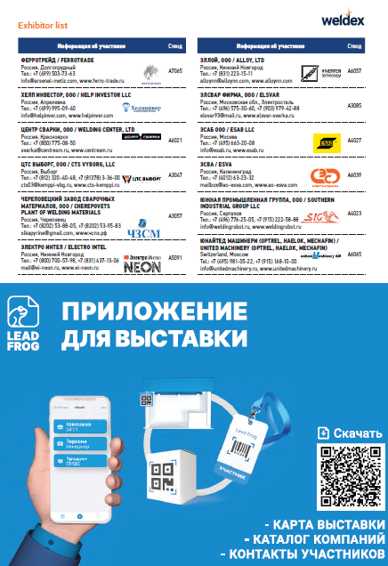
ADVERTISING IN THE EXHIBITION GUIDE
Advertising in the guide allows not only to attract visitors to your stand during Weldex and Fastenex exhibitions, but also to promote the brand and products until the opening of the next year's exhibition, because the guide remains with visitors after the events.
3.1 | Logo in alphabetical order | 70 euro
3.2 | Logo with an arrow pointer to the stand on the hall plan | 360 euro
3.3 | Header Logo (Top/Bottom) | 960 euro
3.4 | Ad page 1/2 | 370 euro
3.5 | Ad page 1/1 | 510 euro
3.6 | Advertising spread | 935 euro
3.7 | Ad cover (2nd, 3rd ad cover) | 1 875 euro
3.8 | Ad cover (4th cover) | 2 050 euro
3.9 | Information about sub-exhibitor | 594 euro
Logo in alphabetical order
Logo with an arrow pointer to the stand on the hall plan
Exhibition advertising opportunities
Путеводитель
Ad page 1/1
Ad page 1/2

Slide 6
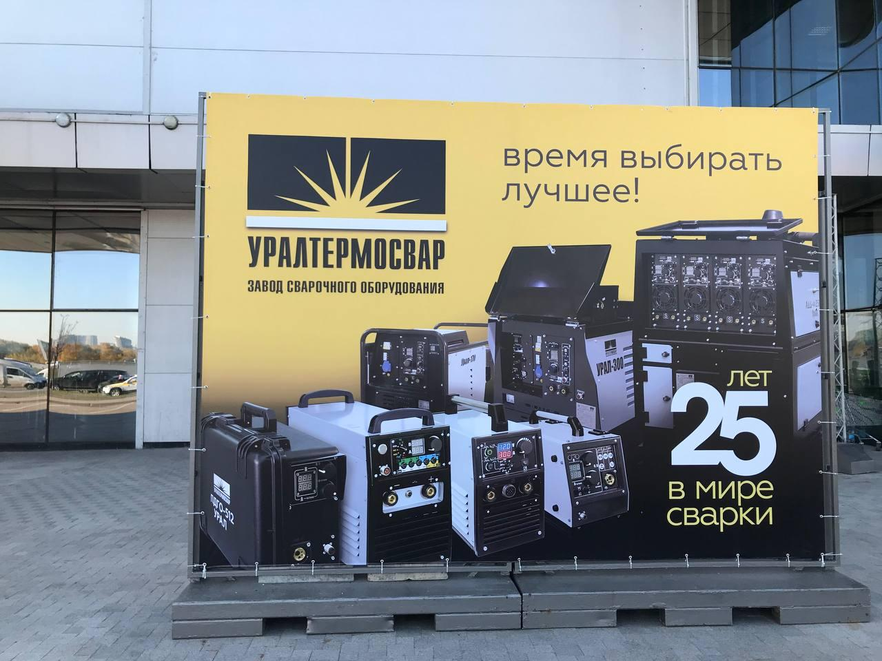

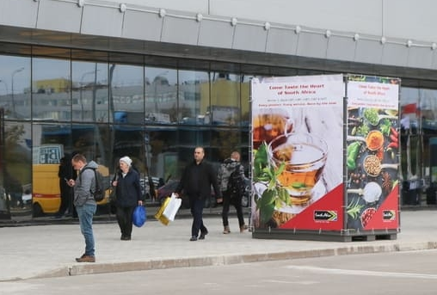
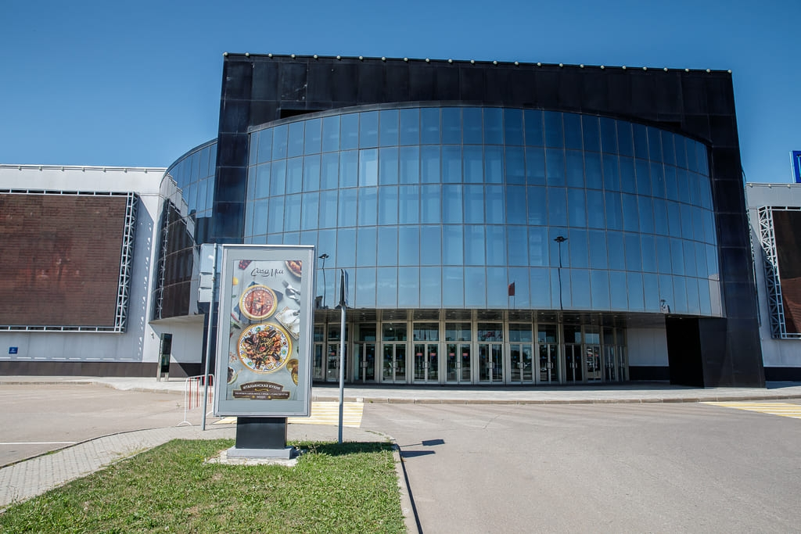
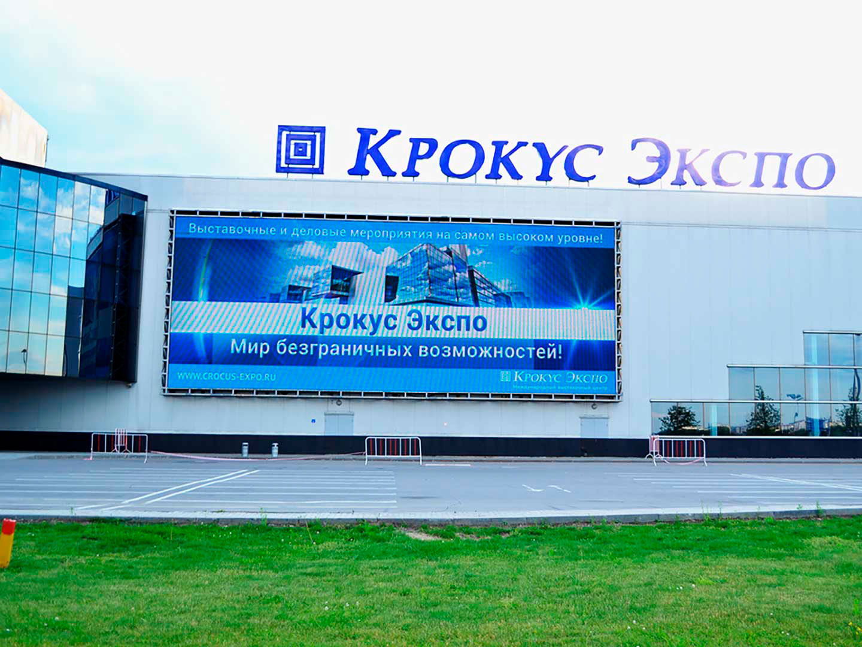
ADVERTISING AT THE VENUE
Ad structures in the street in front of the pavilion
Outdoor advertising will allow you to interest visitors and draw attention to your company already on their way to the exhibition. Drive the maximum target audience to your stand.
Advertising concrete structure
4.1 | Advertising concrete structure 2x3 m | 571 euro
4.2 | Advertising concrete structure 3x3 m | 850 euro
4.3 | Advertising concrete structure 4x3 m | 1 000 euro
4.4 | Advertising concrete structure 6x3 m | 1 500 euro
4.5 | Triangular banner 2x3 m | 1 230 euro
4.6 | Four-sided banner 2x3 m | 1 350 euro
4.7 | Outdoor lightbox, 1.23x2.5 m, one side | 250 euro
4.9 | Advertising video on the screen on the facade of pavilion 1, 10 sec (for 5 days) | 1 565 euro
Triangular banner
Four-sided banner
Exhibition advertising opportunities
Outdoor lightbox
Advertising video on the screen on the facade of pavilion 1

Slide 7
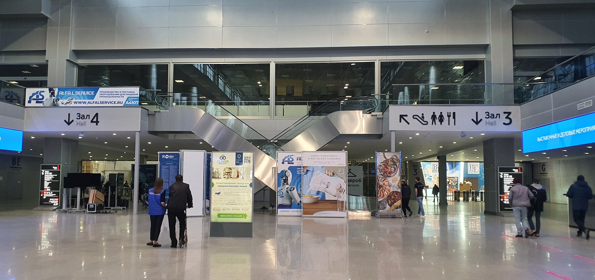
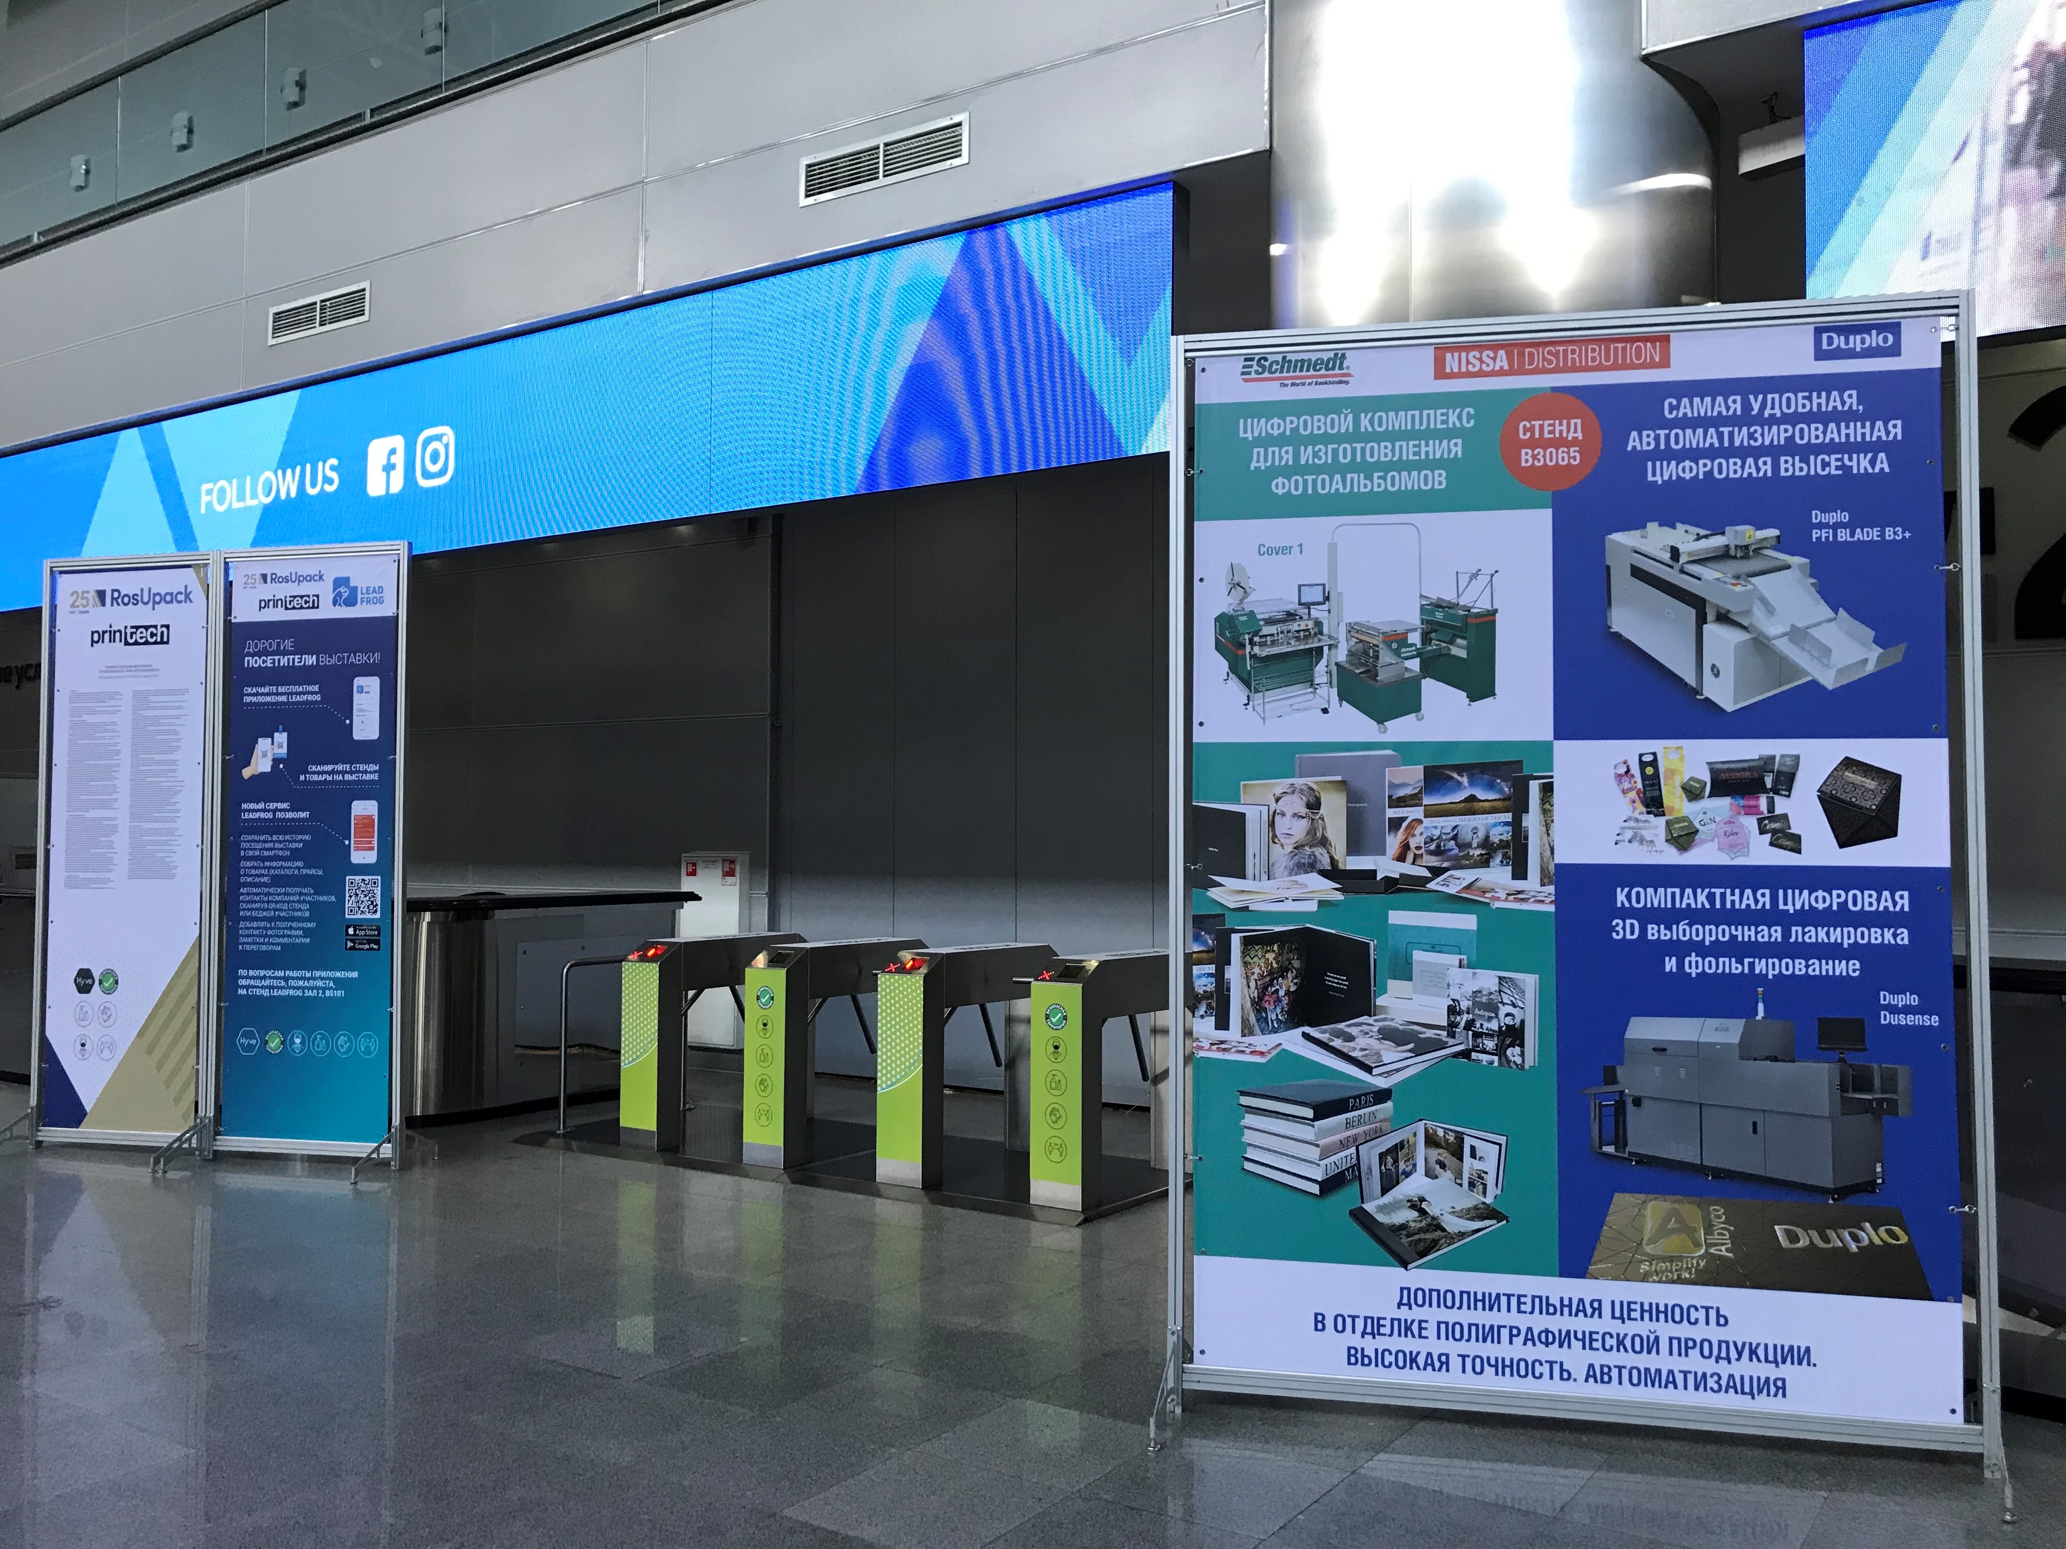
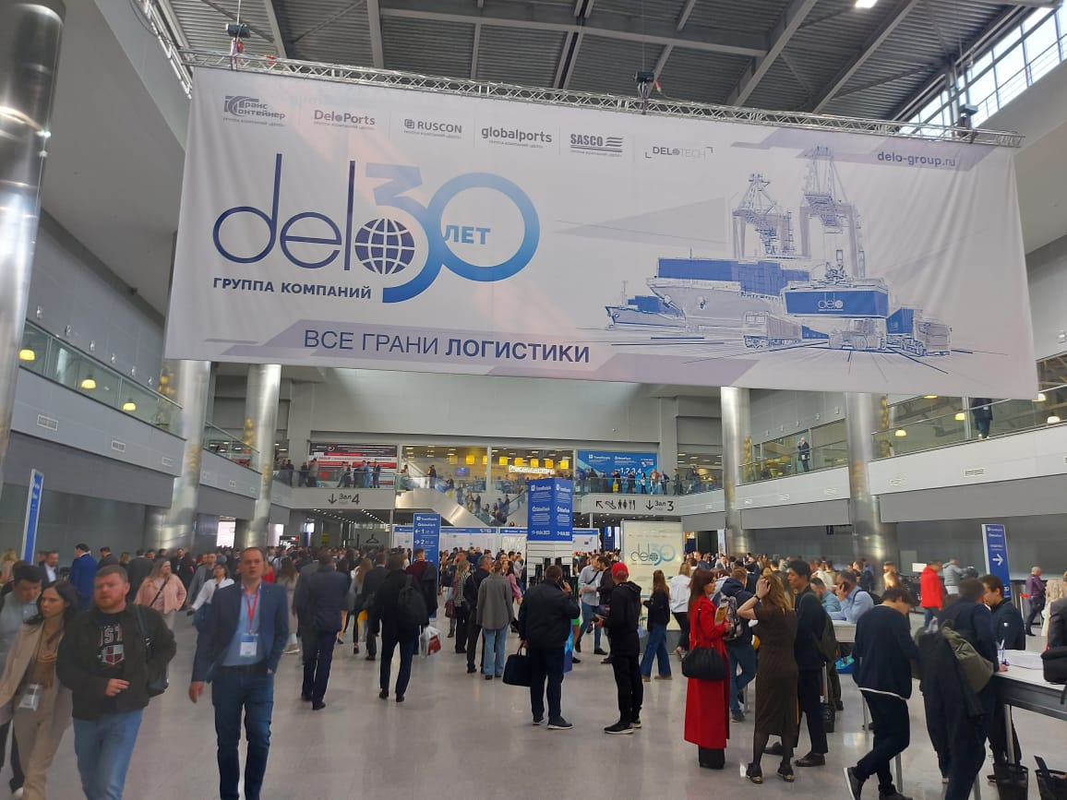
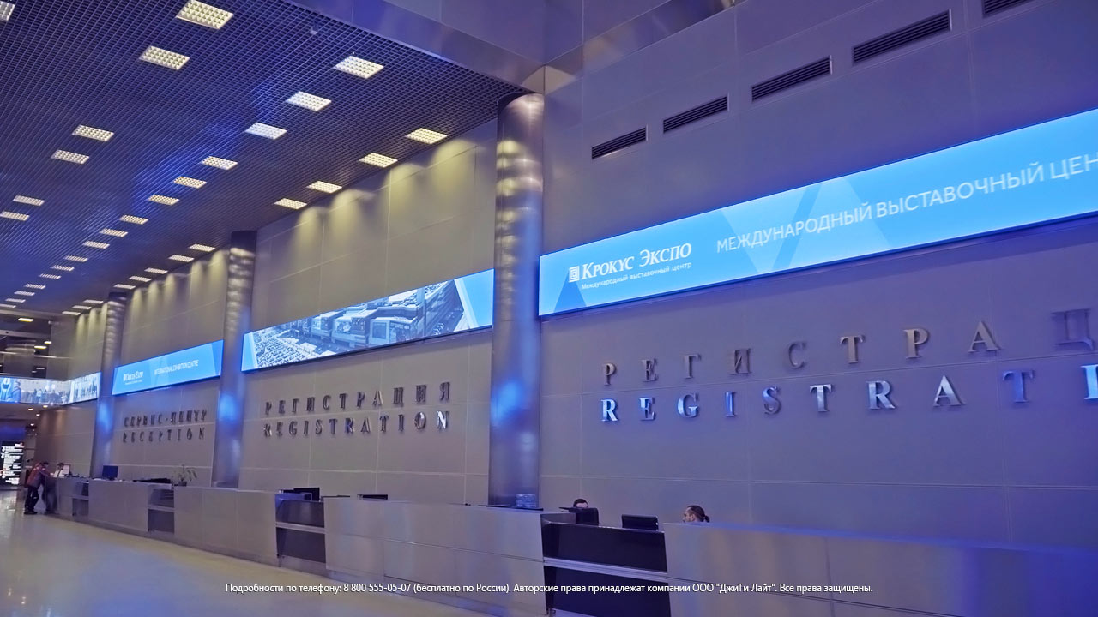
Ad structures in the foyer
Advertising on the territory of the exhibition complex will cover 100% of the target audience, because advertising structures are located in places with the highest concentration of visitors.
Lightbox
5.1 | Lightbox 1.17x1.97 m, front side | 550 euro
5.2 | Lightbox 1.17x1.97 m, back side | 385 euro
5.3 | Advertising structure Octanorm 1x2.9 m | 260 euro
5.4 | Advertising structure Octanorm 2x2.9 m | 440 euro
5.5 | Advertising hanging banner in the foyer 18x6 m, double-sided | 5 100 euro
5.6 | Video on the screen in the foyer, 96x1 m | 1 600 euro
Advertising structure Octanorm
Exhibition advertising opportunities
Advertising hanging banner in the foyer
Video on the screen

Slide 8
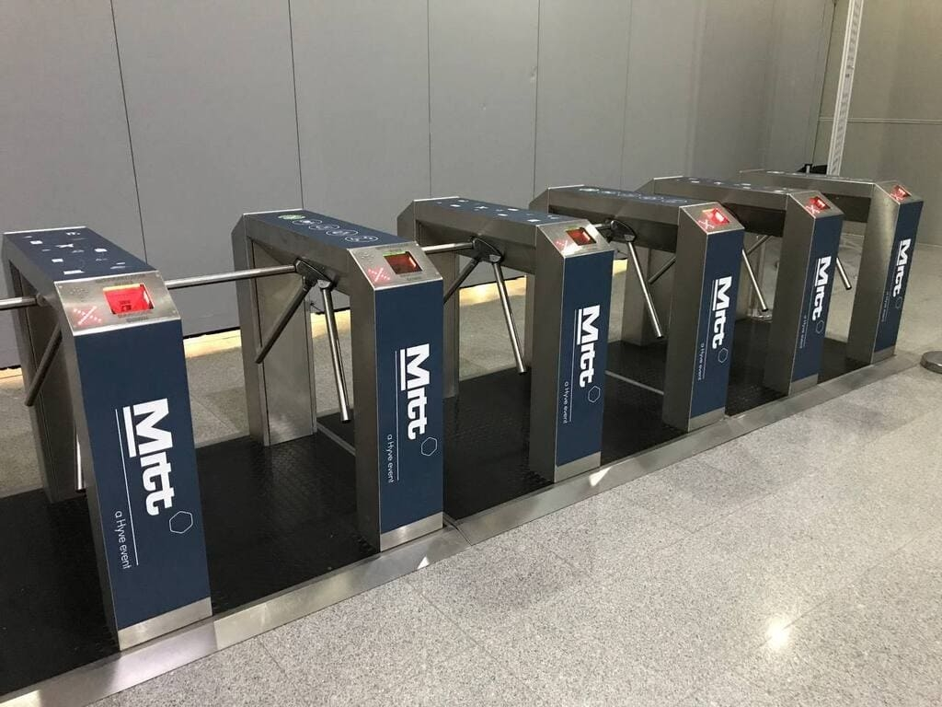
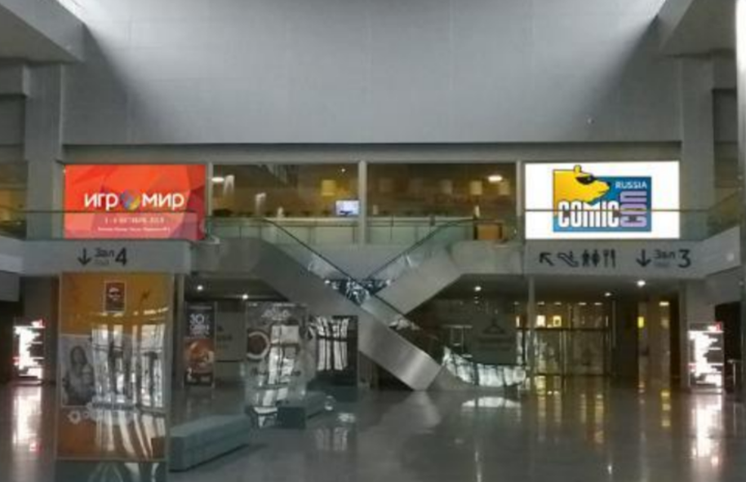
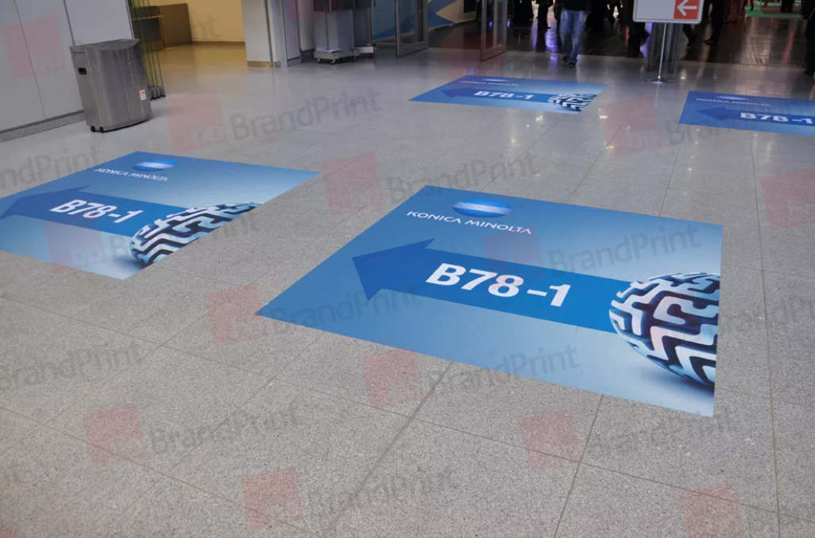
Stickers and surface branding
Use a creative and modern way to catch the eye of potential customers and bring them to your stand.
Branding of turnstiles
6.1 | Branding of turnstiles, 6 items | 1 200 euro
6.2 | Stickers 5.68x0.9 m on the balcony, for 1 piece | 470 euro
6.3 | Stickers 5.6x3 on the glasses of the Pavilion 1 food court, per 2 piece | 6 500 euro
6.4 | Floor sticker 1x1 m | 105 euro
Stickers on the balcony
Exhibition advertising opportunities
Stickers on food court windows
Floor stickers

Slide 9
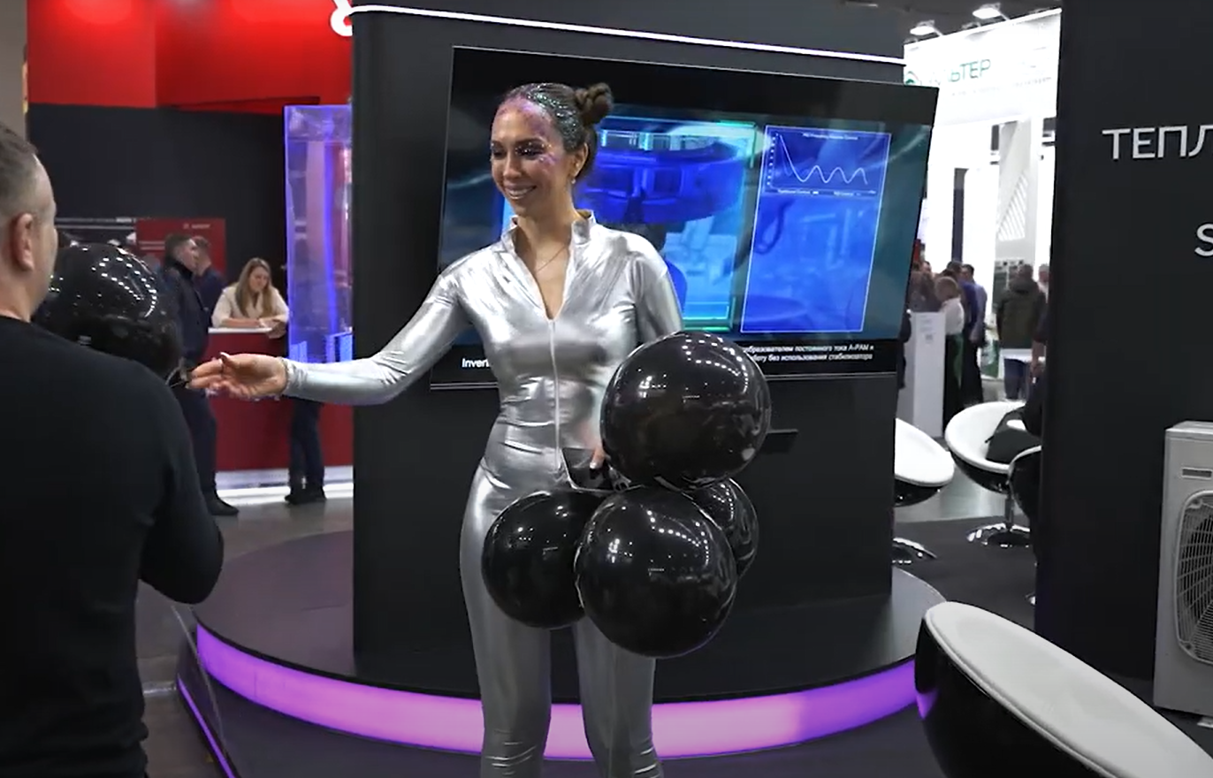
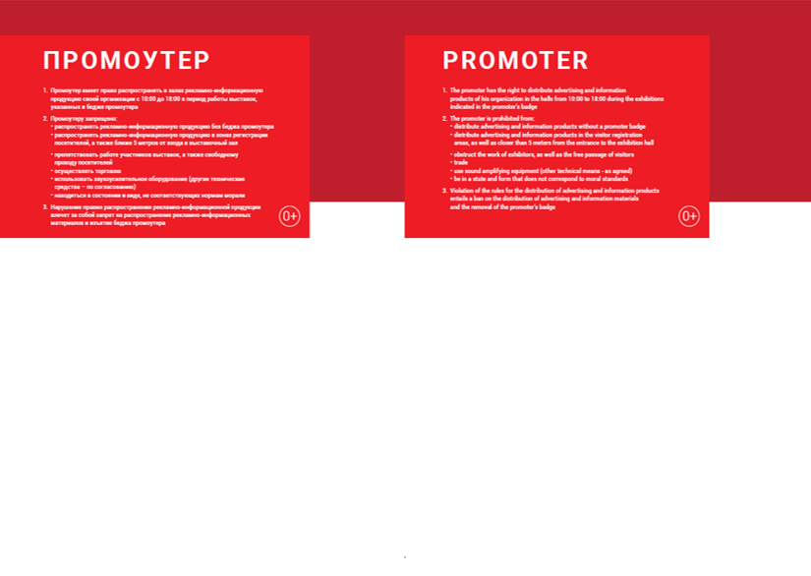
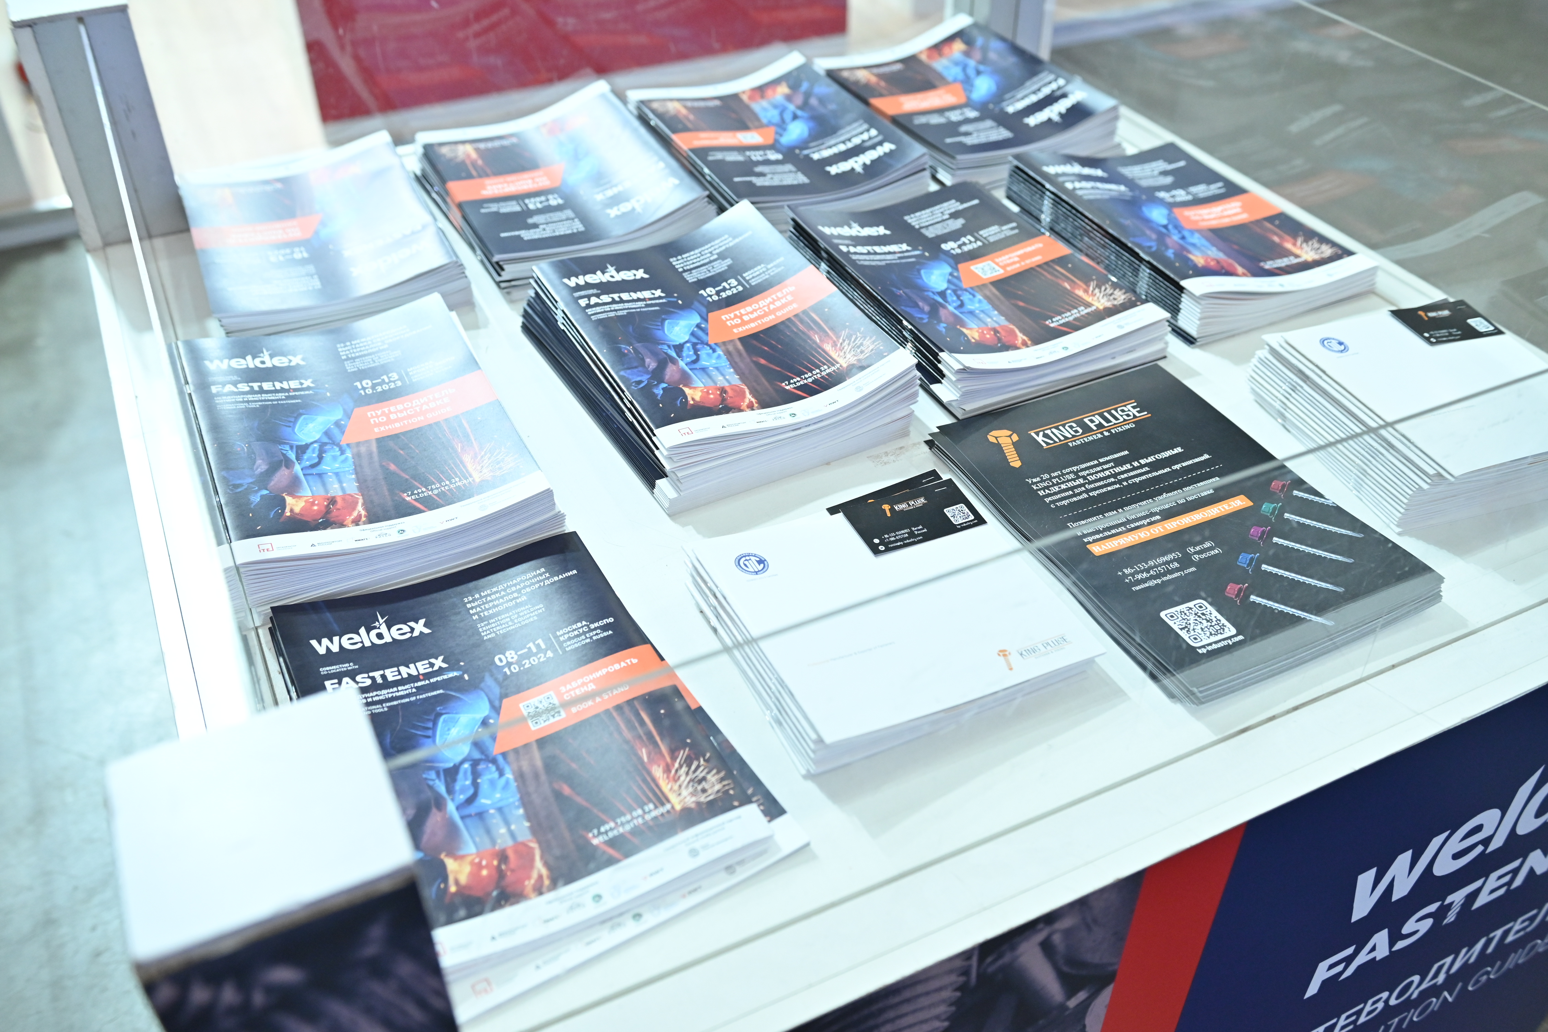
Promoter badge
The badge provides permission to conduct promotional activities in the exhibition hall, which will allow you to cover the entire exhibition audience with advertising in a non-standard form and surprise your target audience, thereby arousing their interest in your stand.
Promoter
7.1 | Promoter badge, 1 item | 440 euro
Material distribution
Use the unique opportunity to tell the audience about your products and services right at the exhibition entrance and capture attention of even those who may not reach you at the show
Promoter badge
Exhibition advertising opportunities
8.1 | Distribution of materials from the registration desk | 715 euro
8.2 | Distribution of materials in cubes (with the Exhibition Guide) in the registration area | 990 euro
8.3 | Distribution of materials in exhibitors’ folders | 880 euro
Distribution of materials in cubes

Slide 10

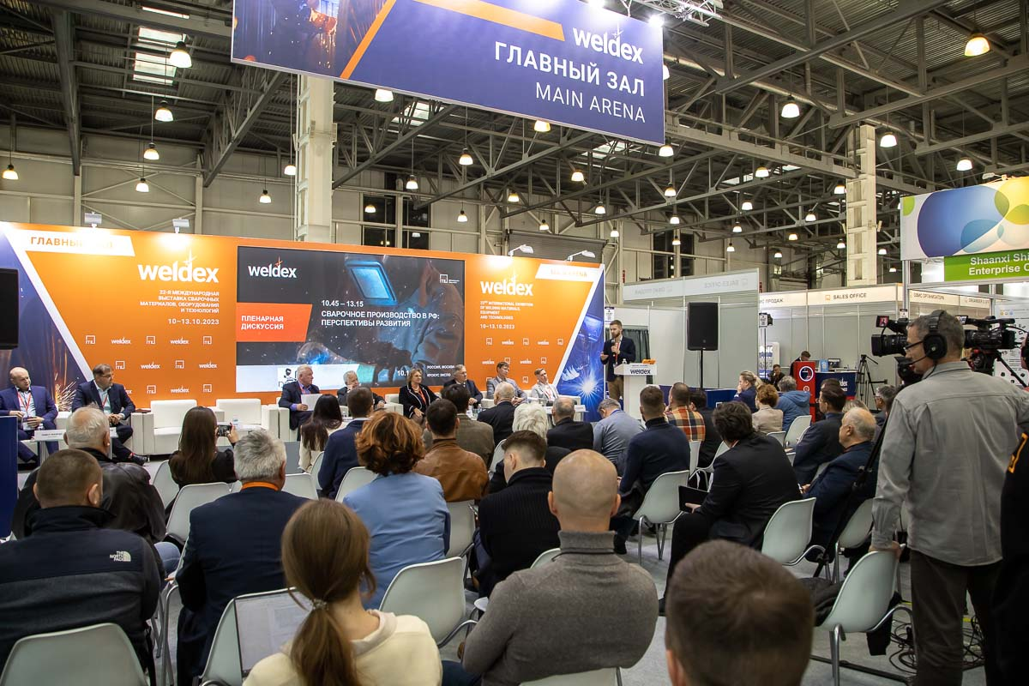

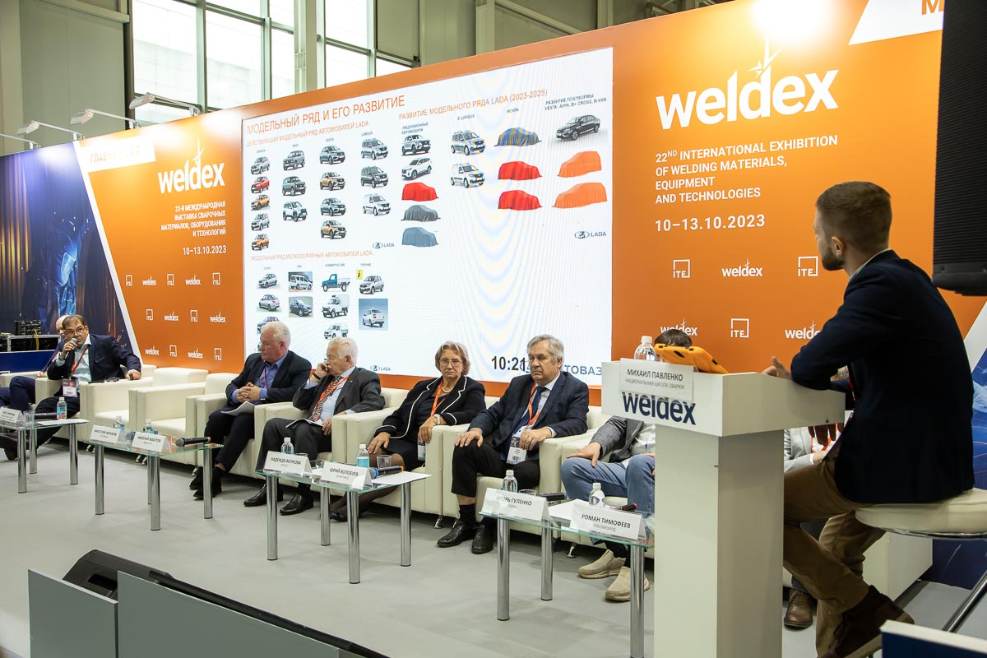
BUSINESS PROGRAM
Rent of conference hall
We invite you to take part in the business program of the exhibition and hold your own conference at the exhibition venue in a rented conference hall.
The Organiser places information about all events on the exhibition website, in the official exhibition guide, on the information structure in the pavilion foyer.
The theme of your event is subject to agreement with the Organiser.
For information on cost and vacant premises, please contact the marketing department:
  Alina Skrebova
  alina.skrebova@ite.group
  +7 996 432 3877
Exhibition advertising opportunities

Slide 11

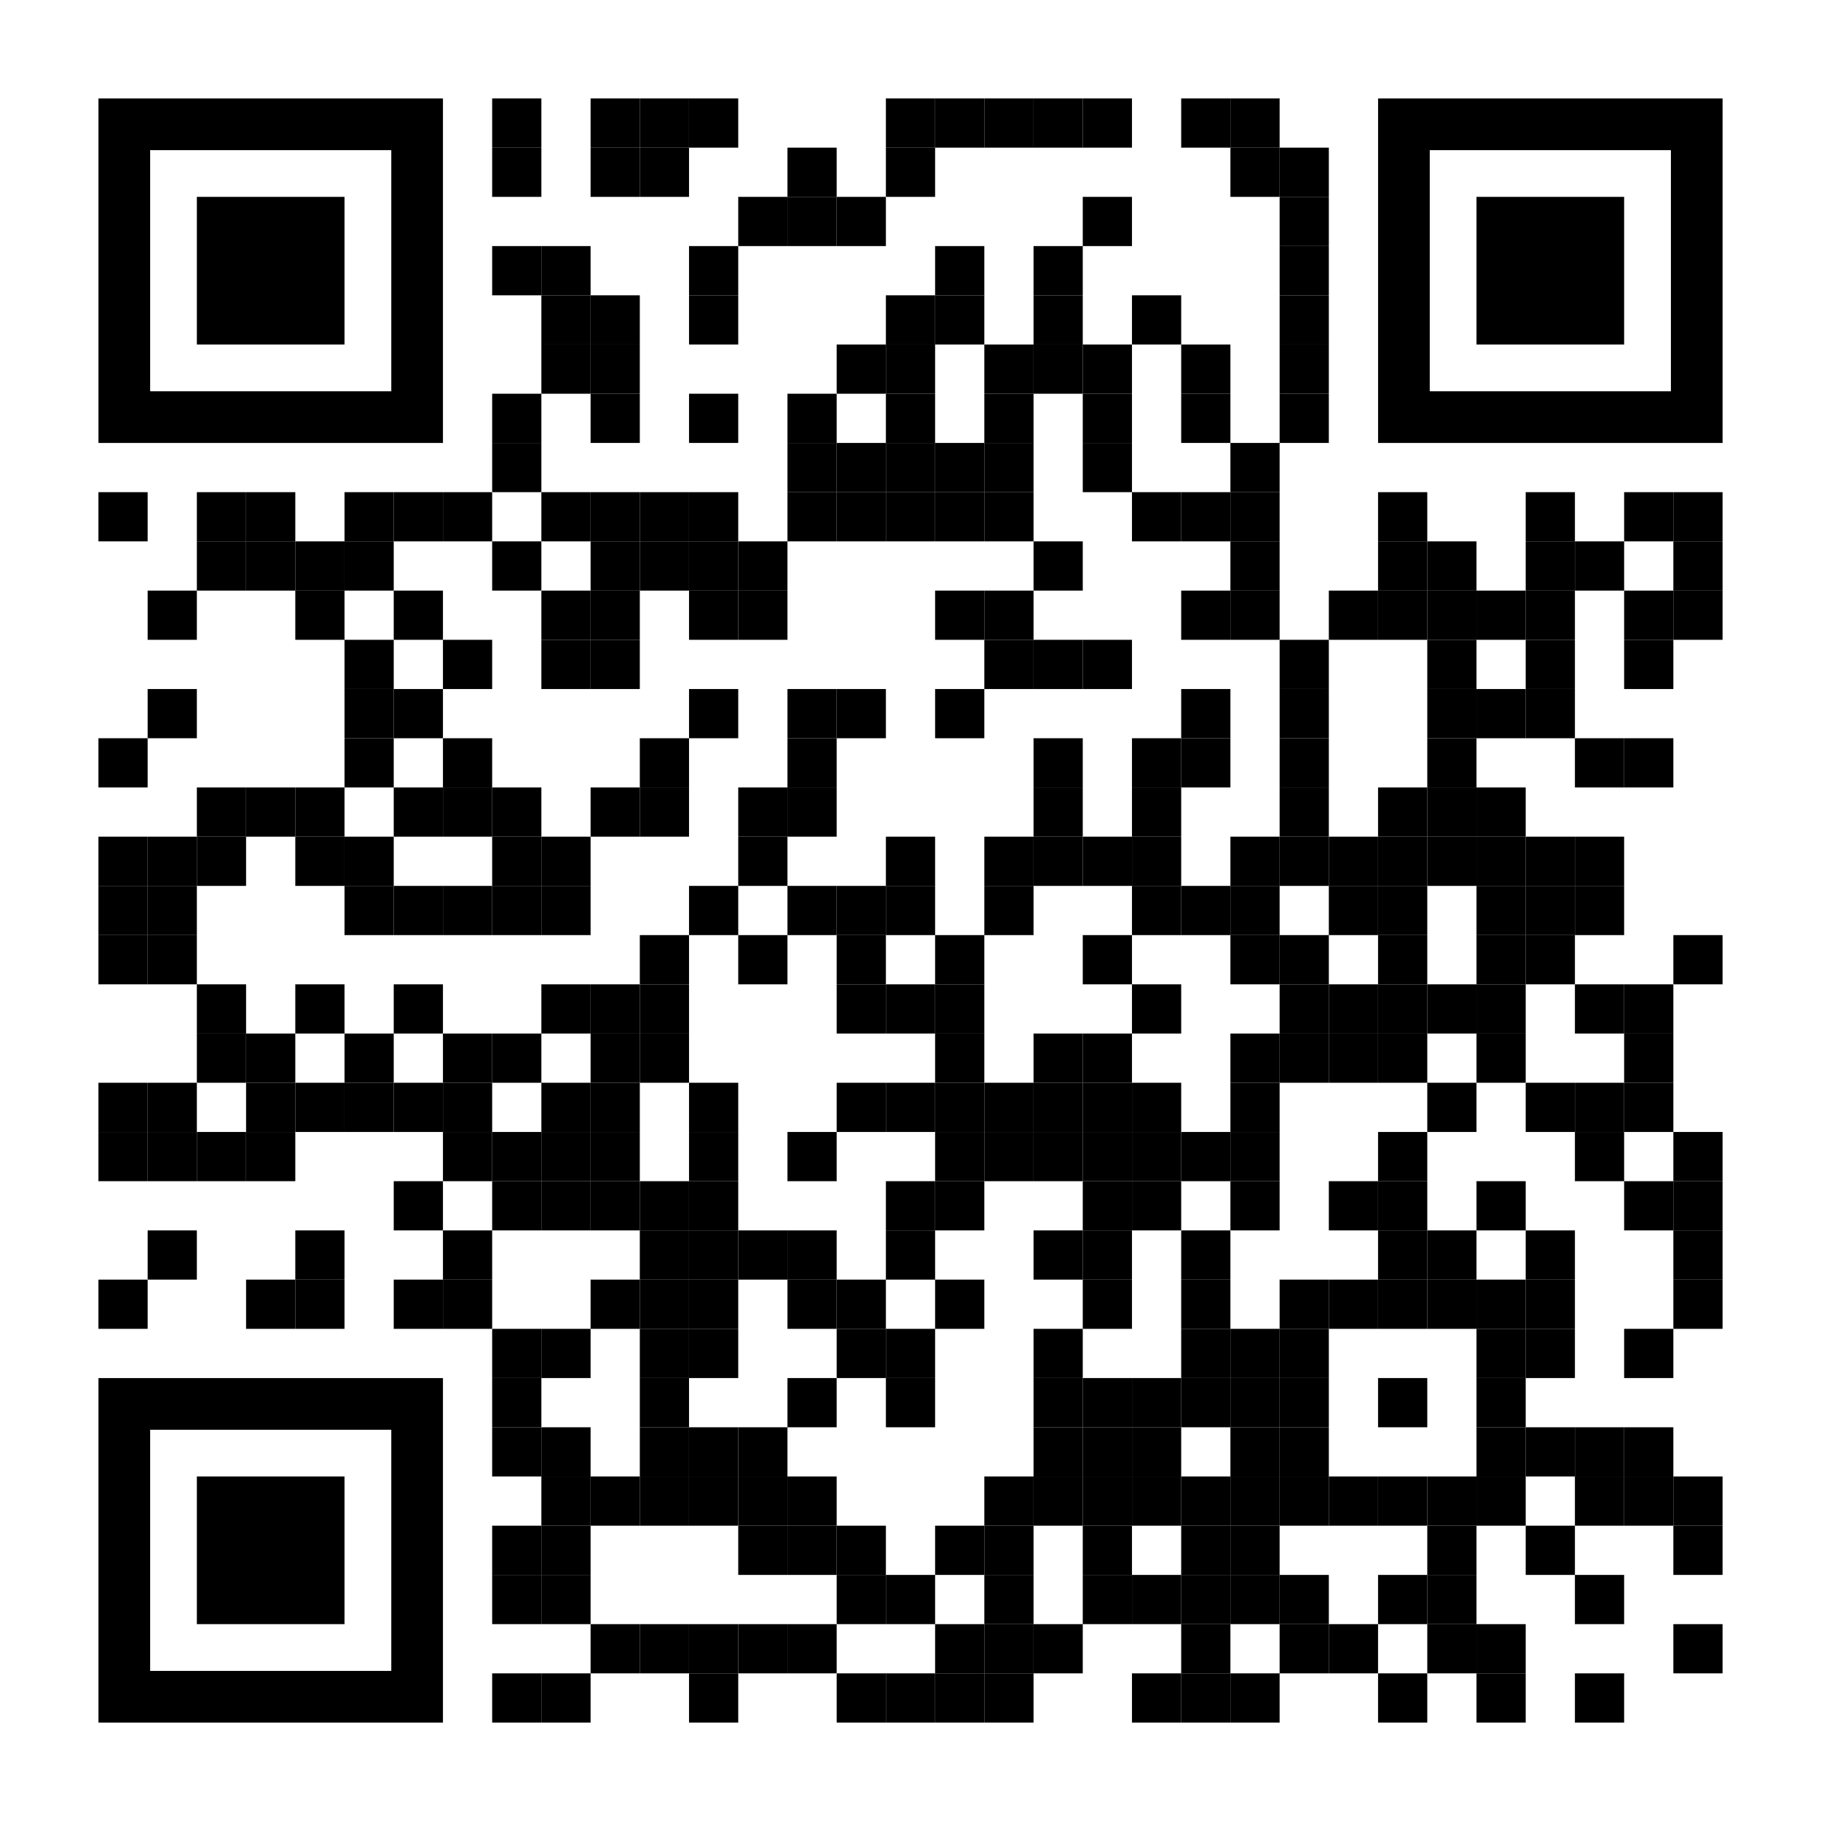
FREE MARKETING TOOLS
To increase the number of visitors to your company’s stand and improve the commercial performance of your participation in the exhibition, we recommend using the free advertising tools we have prepared for you.
Promo codes
The registration for the exhibition is paid. You should send your company unique promo code to clients and partners, so they can receive free electronic tickets to the exhibition. You can receive the promo code from the Organiser..
Placing news about your participation in Weldex or Fastenex in your company emails
Include the information about your participation in the exhibition and your company promo code in your emails over clients and partners. Let them know where and when they can meet your company representatives F2F.
Placing a banner and news about your participation in Weldex or Fastenex on your company’s website
Place a banner and news about your participation to attract even more visitors to your stand. Actively announce your participation in the exhibition on your website. Download the template and fill it out with the number of your stand, unique promo code, information about your products and place it on your company’s website. The banner with your company’s unique promo code will be sent by Julia.Zubkova@ite.group on request.
Invitation to the exhibition as part of your electronic signature
Place an invitation to your company’s stand in your email signature. Copy the exhibition logo and place it in your email signature.
Your business news on the exhibition website
We offer you to send news about your company for placement on the exhibition website. News can include information about innovations, new products/services, and important developments of your company. This will contribute additional interest in your company from a professional audience. Please send news, photos, illustrations, and the logo of your company for placement on the website to: Julia.Zubkova@ite.group
Templates of letters to partners, news, exhibition banners, images for electronic signatures, and the exhibition logo can be found on the exhibition websites.
LEARN MORE
Exhibition advertising opportunities

